Slide 1
Stacks and Queues
CS-2001 Data Structures
Instructor: Syed Zain Ul Hassan

Slide 2
Stack
A stack is an ordered list in which insertion and deletion are done at one end, called TOP. The last element inserted is the first one to be deleted. Hence, it is called the Last in First out (LIFO) or First in Last out (FILO) list
Insertion in a Stack is called Push
Deletion in a Stack is called Pop

Slide 3
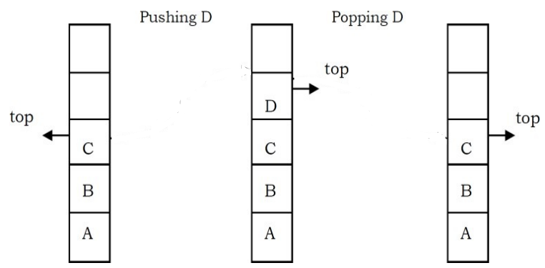
Example

Slide 4
Illustration

Slide 5
Applications
Infix to Postfix expression conversion
In function calls
Balancing of symbols (parenthesis, HTML tags etc.)
Back button in web browsers
Undo (Ctrl+Z) feature
Others...

Slide 6
C++ Implementation: Using Array
class Stack {
int capacity, top = -1;
int * arr;
public:
Stack(int c) {
capacity = c;
arr = new int[c];
}
void push(int val) {
if(isFull( ))
cout << “Stack overflow”;
else {
++top;
arr[top] = val;
}
}
int pop( ) {
if(isEmpty( ))
cout << “Stack underflow”;
else {
int val = arr[top];
arr[top] = -1;
--top;
return val;
}
}
bool isFull( ) {
return (top == capacity -1);
}
bool isEmpty( ) {
return (top ==-1);
}

Slide 7
C++ Implementation: Using Singly Linked List
Use the same functions provided with singly linked list
Use only Insert at the end function and remove the other insertion functions
Use only Delete from the end function and remove the other deletion functions

Slide 8
Queue
A queue is an ordered list in which insertions are done at one end (rear) and deletions are done at other end (front). The first element to be inserted is the first one to be deleted. Hence, it is called First in First out (FIFO) or Last in Last out (LILO) list

Slide 9
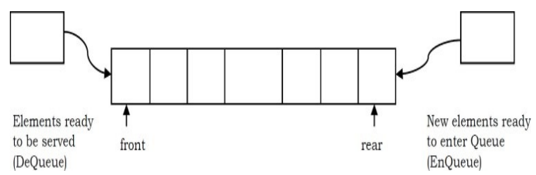
Example

Slide 10
Illustration

Slide 11
Applications
Scheduling tasks (in any area)
Data transfer in networks
Operating system process scheduling

Slide 12
C++ Implementation: Using Array
class Queue {
int capacity, count = 0, front = 0, rear = -1;
int * arr;
public:
Queue(int c) {
capacity = c;
arr = new int[c];
}
void enqueue(int val) {
if(isFull( ))
cout << “Queue overflow”;
else {
rear = (rear + 1) % capacity;
arr[rear] = val;
++count;
}
}
int dequeue( ) {
if(isEmpty( ))
cout << “Queue underflow”;
else {
front = (front + 1) % capacity;
--count;
int val = arr[front];
arr[front] = -1;
return val;
}
}
bool isFull( ) {
return (count == capacity);
}
bool isEmpty( ) {
return (count == 0);
}

Slide 13
C++ Implementation: Using Singly Linked List
Use the same functions provided with singly linked list
Use only Insert at the end function and remove the other insertion functions
Use only Delete from the beginning function and remove the other deletion functions

